Slide 1
MAJOR PROJECT
Study Buddy
MENTOR- DR. MALA SARASWAT

Slide 2

Our Team
1. Satwik (CSE C- 1803210134)
2. Vrinda Kohli (CSE C- 1803210183)
Swapnil Gupta (CSE A- 1803210156)
Dr. Mala Saraswat

Slide 3

Problem Explained

Slide 4
THE PROBLEM
In this competitive word where everyone is preparing for any sort of exams the students need proper guidance and motivation how to study.
OUR MOTIVATION: since we are students, we ourselves have been at a helpless place when we have to study weeks before out exams for finding exam material as well as dealing with exam anxiety.
PROJECT OBJECTIVE: The objective of this project is to help students appearing for different exams by providing them proper resources and mentors under one platform.
SCOPE OF PROJECT: Our project is for students preparing for class 10th and 12th board exams. It can also be accessed by schools and colleges as a source of their curriculum.

Slide 5
Proposed Method

Slide 6
PROPOSED METHODOLOGY
Step 1) Developing a system design for the website.
Step 2) The website will include generating automatic timetable, providing study material and contacting a teacher incase of any queries.
Step 3) Connecting the whole website to a database so that we can have a record of all the students who register.
Step 4) Connecting the site to sockets IO that students can communicate with each other (discussion forum).
Step 5) Future perspective analyzing our dataset and applying machine learning algorithms to predict or get output

Slide 7
Literature Survey

Slide 8
LITERATURE SURVEY
Websites like Udemy, Coursera, etc are there which provide you with courses and certification but our perspective is broader one.
Websites like Two Waits, Brainly, etc provide with just study material and questions answers.
But we are focusing not only on study material but also automatic time table generation, online faculties and test series which make our work unique.

Slide 9
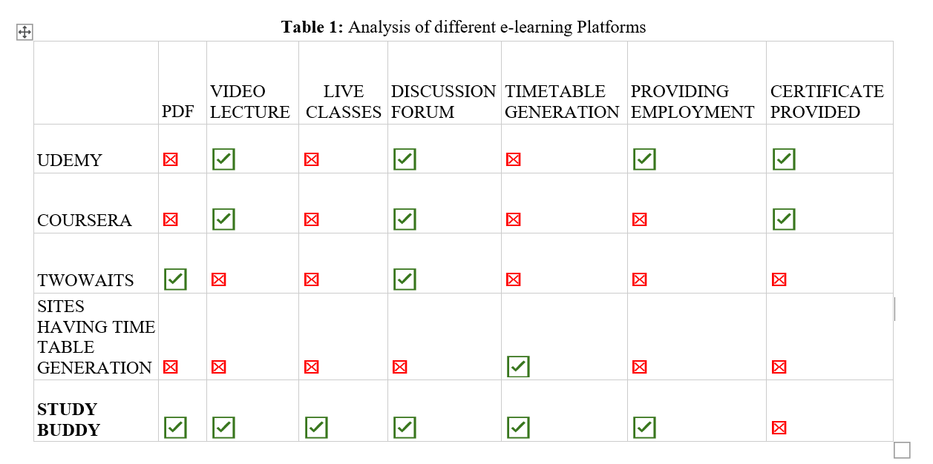
LITERATURE SURVEY

Slide 10
Deliverables

Slide 11
DELIVERABLES
Major output of the project: is to provide student with such an environment where they can focus on their studies and prepare for their exams.
The second objective: of this project is to help retired teachers by providing them extra source of income by helping students for their queries and problem.
Finally: Schools and Colleges can also use our curriculum to teach students which we our thinking as our future perspective.

Slide 12
Software and Hardware Requirements

Slide 13
Software and Hardware
Requirements
Software Used:
Can run on any web browser
Spring Boot
Java
ReactJS
Node JS
Hardware Requirements:
Laptop/ computer
Core i3 8th generation
RAM 8gb (minimum)

Slide 14
ER Diagram

Slide 15
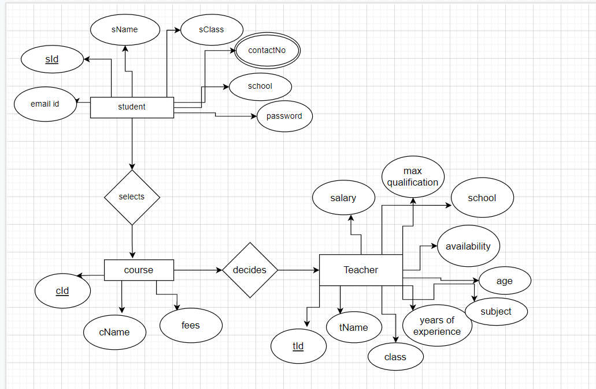
ER-DIAGRAM

Slide 16
Gantt Chart

Slide 17
GANTT CHART
Months | September | October | November | November- January | January-March | May
Project Proposal
API Study
UI Design
Backend Development
Frontend Development
Testing and Bug Fixes

Slide 18
DFD’s

Slide 19
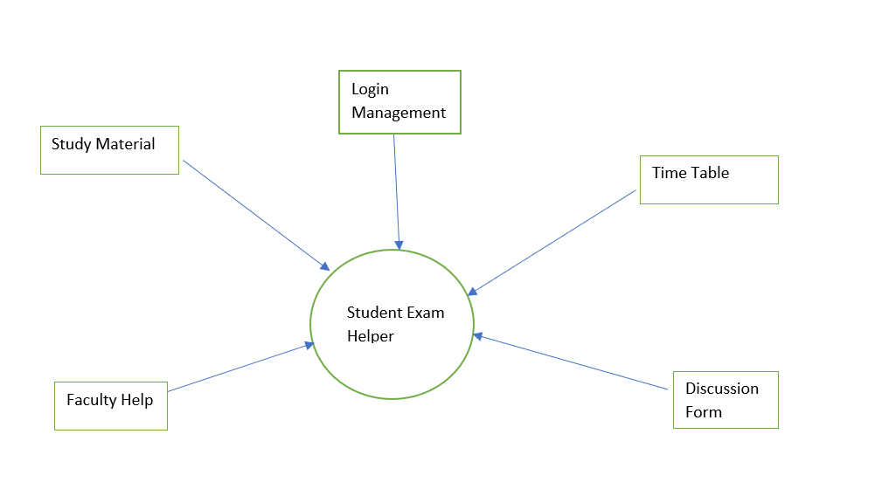
DFD LEVEL-0

Slide 20
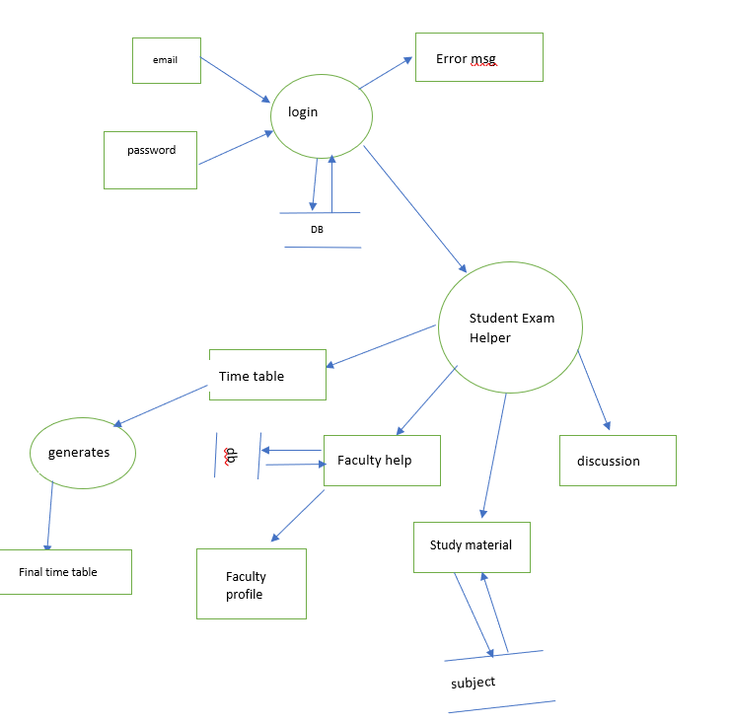
DFD LEVEL-1

Slide 21
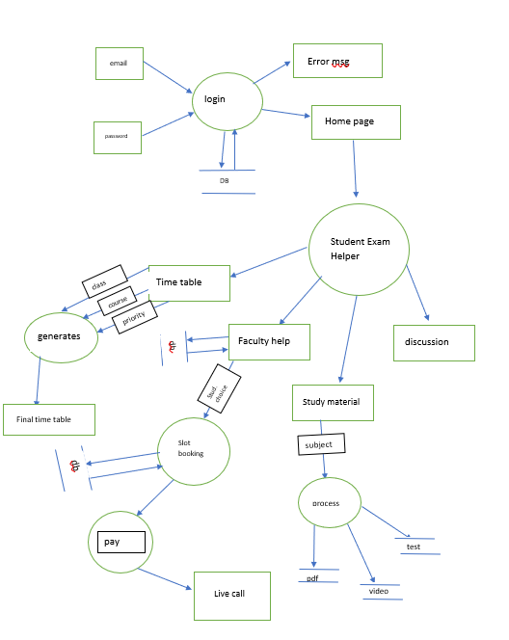
DFD LEVEL-2

Slide 22
References

Slide 23
REFERENCES
[1] Jena, P.K., 2020. Online learning during lockdown period for covid-19 in India. International Journal of Multidisciplinary Educational Research (IJMER), 9.
[2] Ambhore, S., Walke, P., Ghundgrudkar, R., Alone, A. and Khedkar, A.,
Automatic Timetable Generator.
[3] Abhinaya, V., Sahithi, K. and Akaanksha, K., 2019. Online Application of Automatic
Time-Table Generator. International Research Journal of Engineering and Technology
(IRJET), 6(02).
[4] Qiu, R., 2020. Udemy: Blended and e-Learning for Transforming Teaching and Learning. In Anticipating and Preparing for Emerging Skills and Jobs (pp. 215-220). Springer, Singapore.
[5] Muthuprasad, T., Aiswarya, S., Aditya, K.S. and Jha, G.K., 2021. Students’ perception and preference for online education in India during COVID-19 pandemic. Social Sciences & Humanities Open, 3(1), p.100101.
[6] Hnatkowska, B. and Cebinka, M., 2021. Activity Diagram Generation Based on Use-Case Textual Specification. Computing and Informatics, 40(4), pp.772-795.

Slide 24

Thank You ☺

